Slide 1
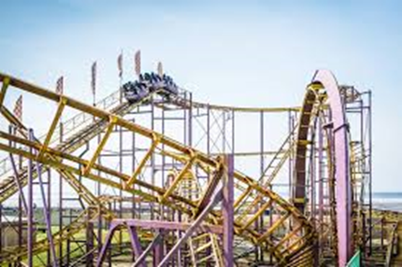
OUR SALE WEST TRIP TO SOUTHPORT
Our Sale West are hosting a Coach Trip to Southport
Saturday 17th August,
only £10.00 per person!
(under 3s go free if sat on an adult’s knee)
If you would like to go to the flower show, tickets can be purchased on the day or the early bird savers can be purchased online http://www.southportflowershow.co.uk/ or by phone on 0344 8000 410
Pick up: 9.30am at Sale West Community Centre
Depart Southport at 5pm
TO BOOK YOUR TICKET, CALL PIP ON 07920 497961 or CATH ON 07776 594832 OR CALL INTO THE OFFICE IN SALE WEST YOUTH CENTRE,
NEWBURY AVENUE, SALE, M33 4QW
ALL YOUNG PEOPLE (under 16) MUST BE ACCOMPANIED BY ADULT
STRICTLY NO ALCOHOL ALLOWED ON THE COACH

